Slide 1
Gamifying the Digital Comic: Creative Labour and the Future of Digital Comics in a Neoliberal World by Queenie Chan
www.queeniechan.com/phd

Slide 2
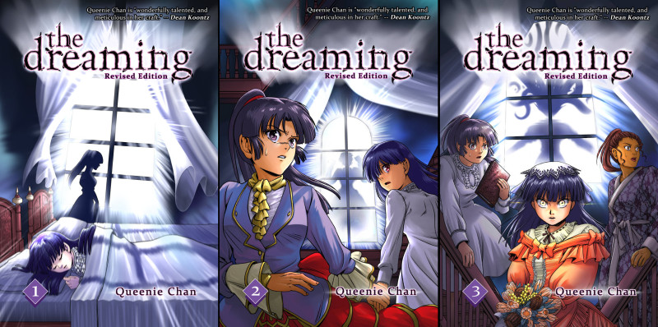
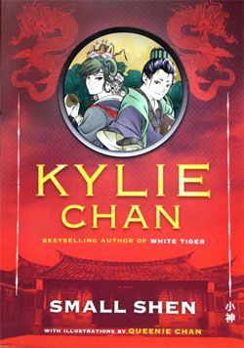
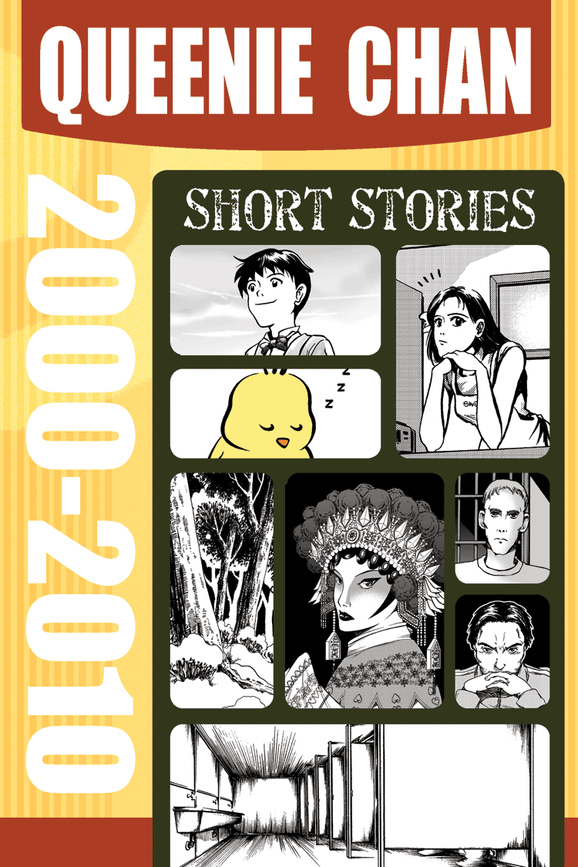
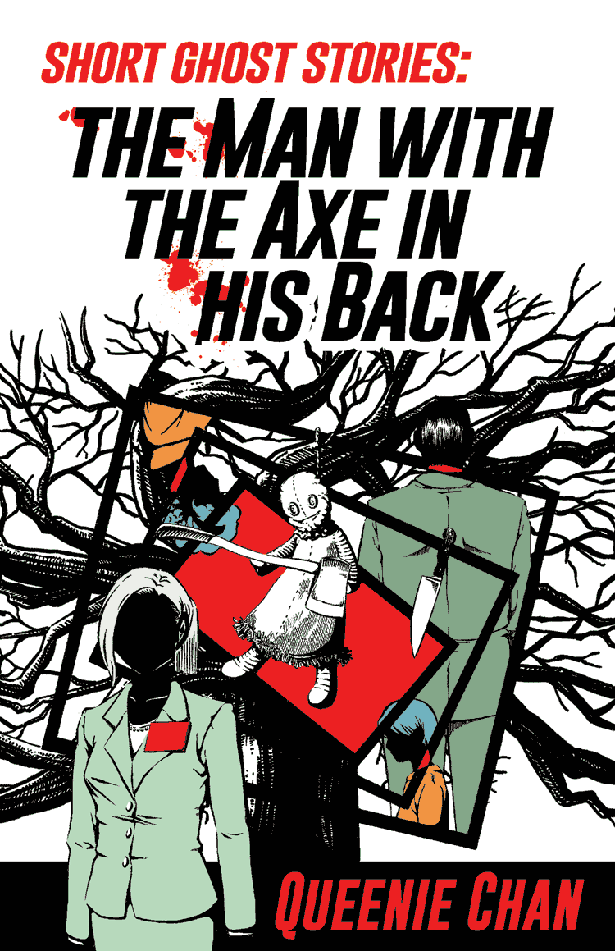
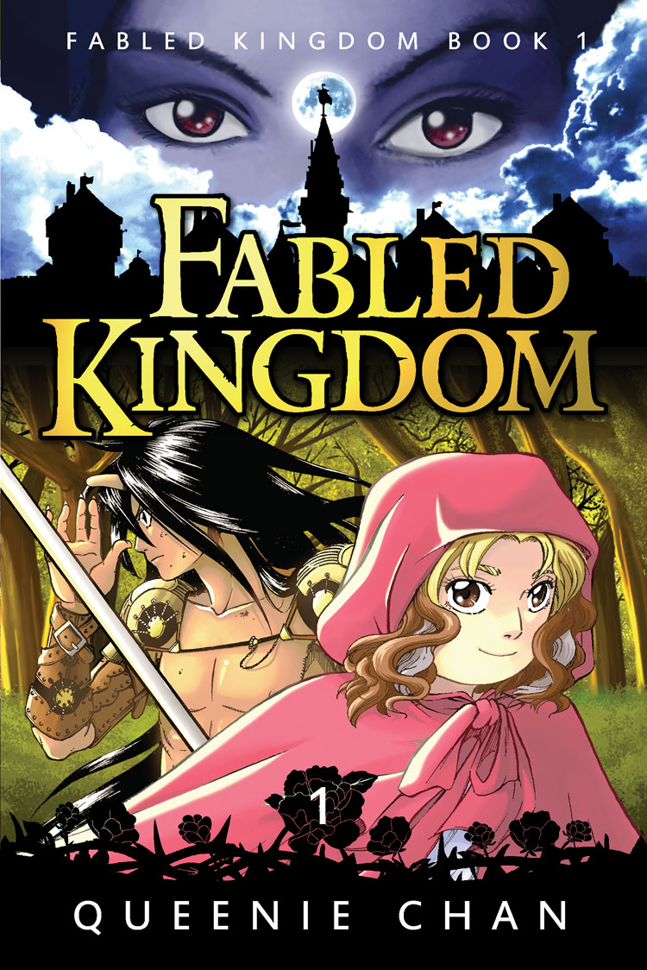
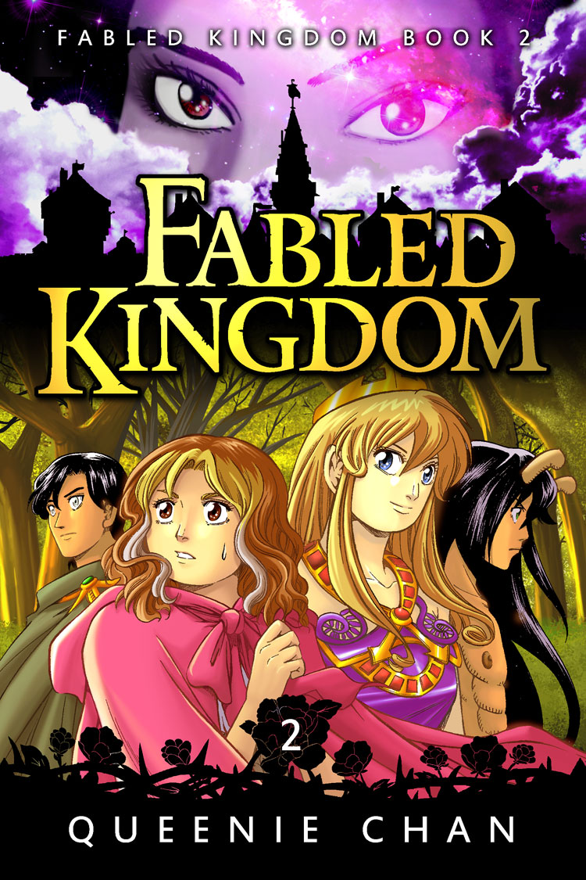
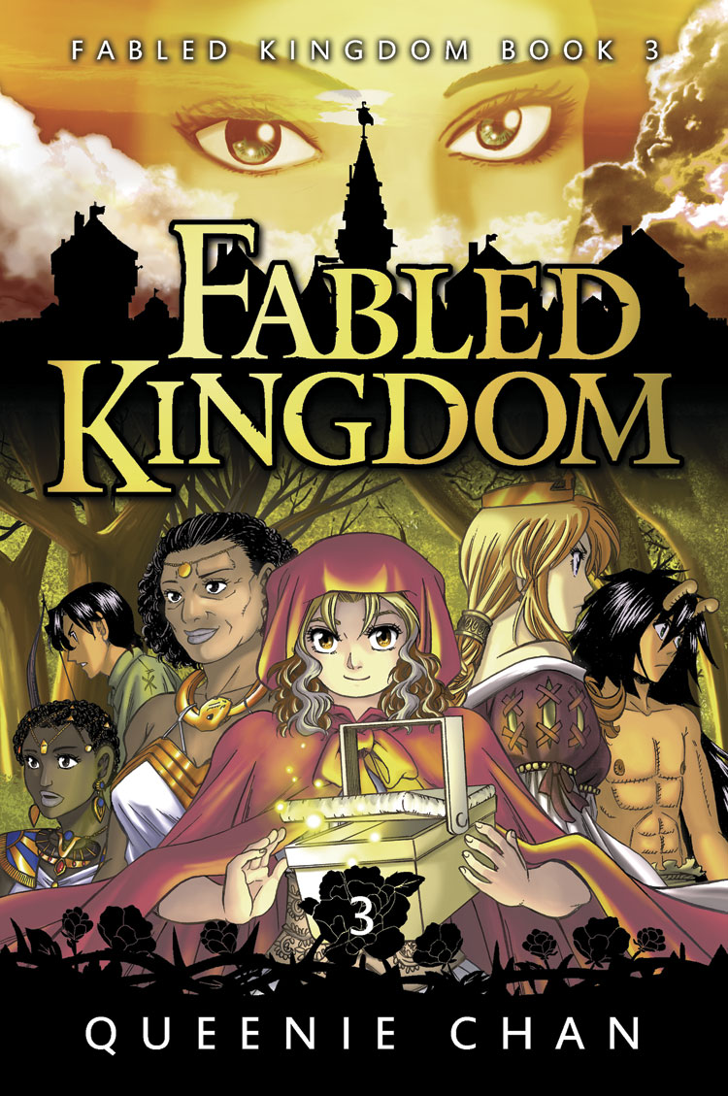

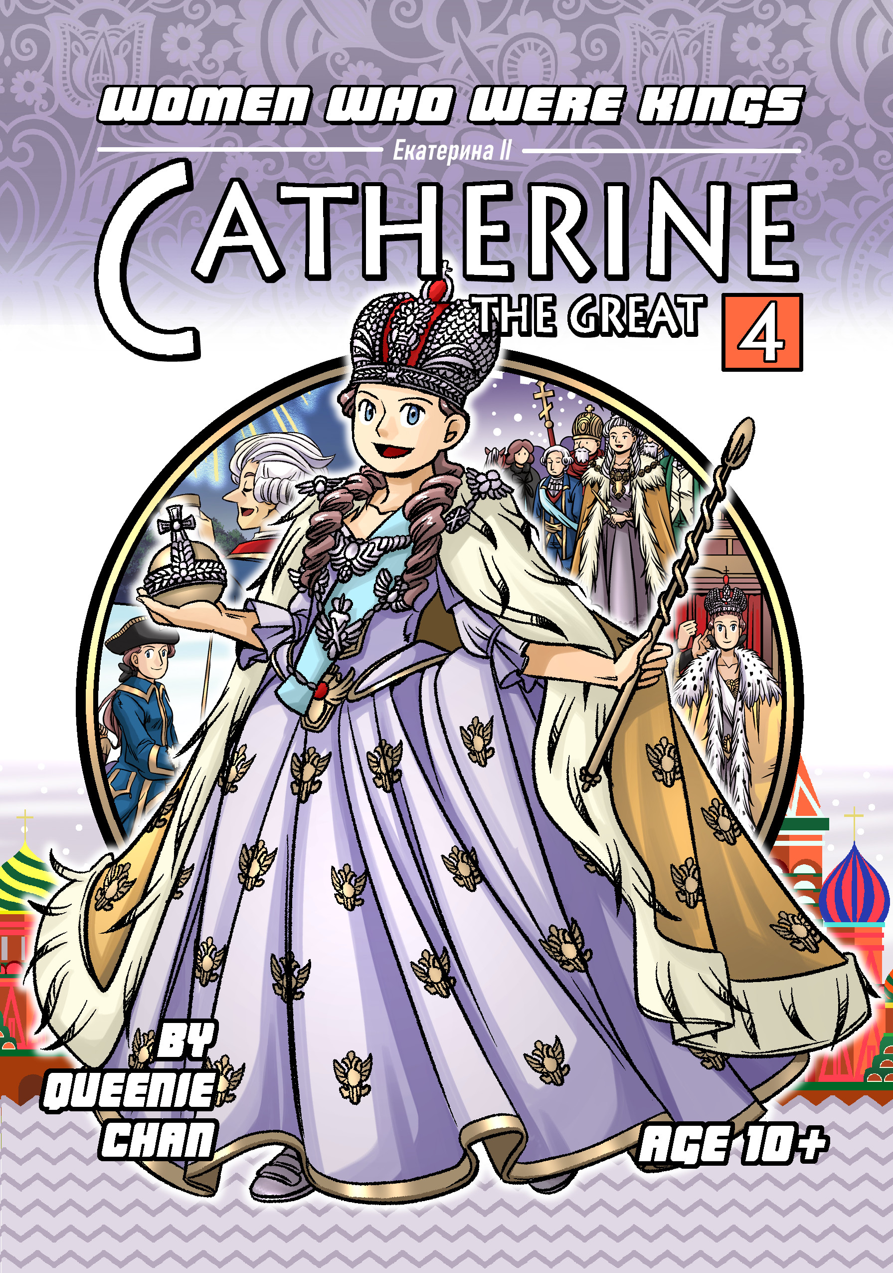
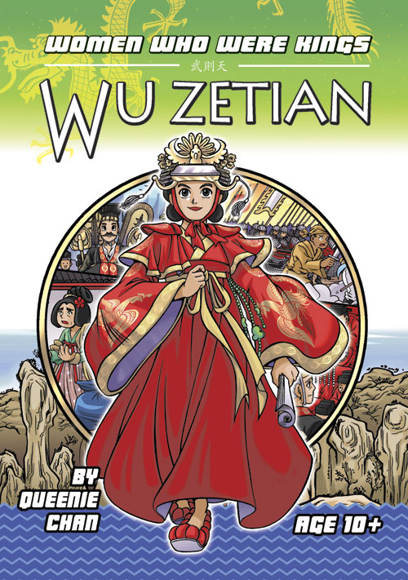
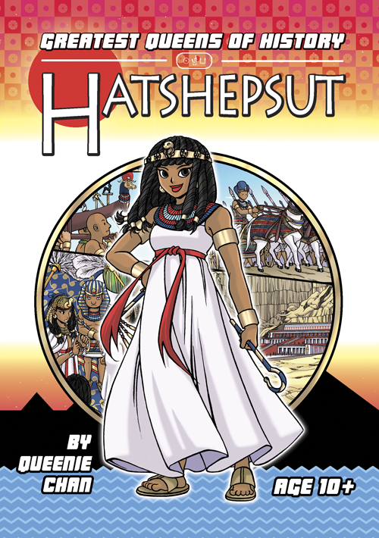
My work 2005~2024

Slide 3
What is neoliberalism?
An ideology, closely related to the socio-economic-political system of capitalism
A controversial term in academia -- no agreed-upon definition for in the humanities
Blamed to so many societal ills, it’s almost like an accusation
useful in an activist context to affect a particular left-wing position
“Whatever the term neoliberalism is meant to describe, the most common narrative can be very broadly framed as some sort of deliberate shift, in recent macro-political history, away from a sort of public-collective mindset to that of a private-individualised mindset” (Barnett, 2005, p. 8; Venugopal, 2015, p. 182)

Slide 4
Neoliberalism – key points
According to Marxist Academic David Harvey:
Believes in the efficiency of the free market to solve problems
Believes in the sanctity of individual agency and self-sufficiency
All aspects of life can be privatised and reduced to units of profitability
“[…]There's no such thing as society. There are individual men and women and there are families. And no government can do anything except through people, and people must look after themselves first. It is our duty to look after ourselves and then, also, to look after our neighbours." (Margeret Thatcher, 1987)
There is no alternative to this system, it is inescapable and all encompassing

Slide 5
Precarious work, intangible goods
Comic creators don’t really fit into the traditional Marxist paradigm of capitalism VS protelariat (ie. factory owners VS factory workers)
They’ve always been self-employed rather than salaried
Unlike other “precariats” (ie. workers who do casual work), their industries are seen as “glamourous” → downward pressure on wages
Comic creators create intangible goods (ie. intellectual property)
Comic books can come in physical books, but they can be digital
They’re cultural content, whose dimensions are abstract, symbolic and informational → production of subjectivity
Finds its most powerful expression through networked technologies (ie. internet), where they can spread quickly, widely and at low cost

Slide 6
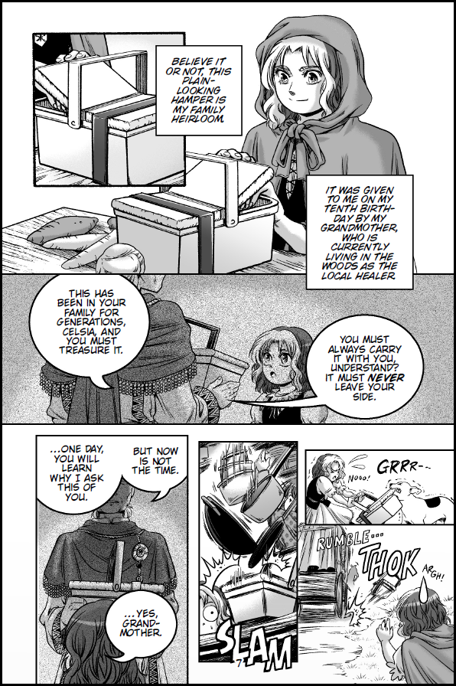
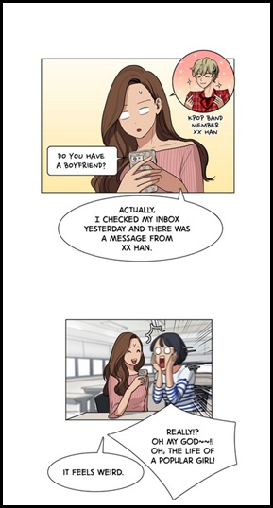
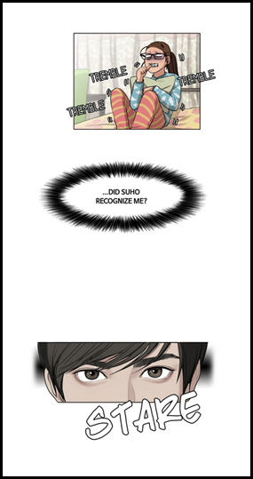
Digital comics creators & webtoons
Traditional Comics – for printed page
(“Fabled Kingdom” by Queenie Chan)
Webtoon – from webtoons.com (“True Beauty” by Yaongyi)

Slide 7
Creators & the Global internet Platform
Comics is labour intensive, so creators bear the emotional, financial and health costs of production
Creators need to find a comics platform that guarantees readers → eventual profit???
Due to internet consolidation, the digital comics is now dominated by big webtoon platforms owned by multinationals
Comic creators therefore needs to shape their comics to fit the requirements of platforms
Unequal power dynamics in the pre-internet era between print media and creators are reproduced
Except now it’s global and transnational
Competition is now international
Local laws can’t address labour violations in a transnational context

Slide 8
Webtoons & the Korea wave
Comics Studies is a relatively new field in English-speaking academia → Rarely address digital comics
Some comic scholars don’t think “digital comics” is the same as traditional “comics” → different medium
Webtoons is not really a grassroots phenomenon
Has support from the South Korean government, and is part of the “Korea Wave” initiative
Meant to use Korean culture (k-pop, k-drama, etc) to promote the standing of the country abroad
Is therefore one part of a transmedia juggernaut
Tends to privilege Korean webtoons and creators for this reason

Slide 9
Platform capitalism
Popularised by Nick Srnicek in 2016
Refers to the intersection of neoliberalism and digital capitalism
A “platform”, at its most basic level, can be defined as digital infrastructure which allow two or more people the means to interact, typically as a marketplace
Sometimes tools are also offered to allow users to build and offer their own services to others
So platform owners gather all points of data that is generated on that network, including its users
They then resell the data to advertisers, to shape better consumers
Has a tendency towards monopolisation
Reduces everything on its platform to “content”

Slide 10
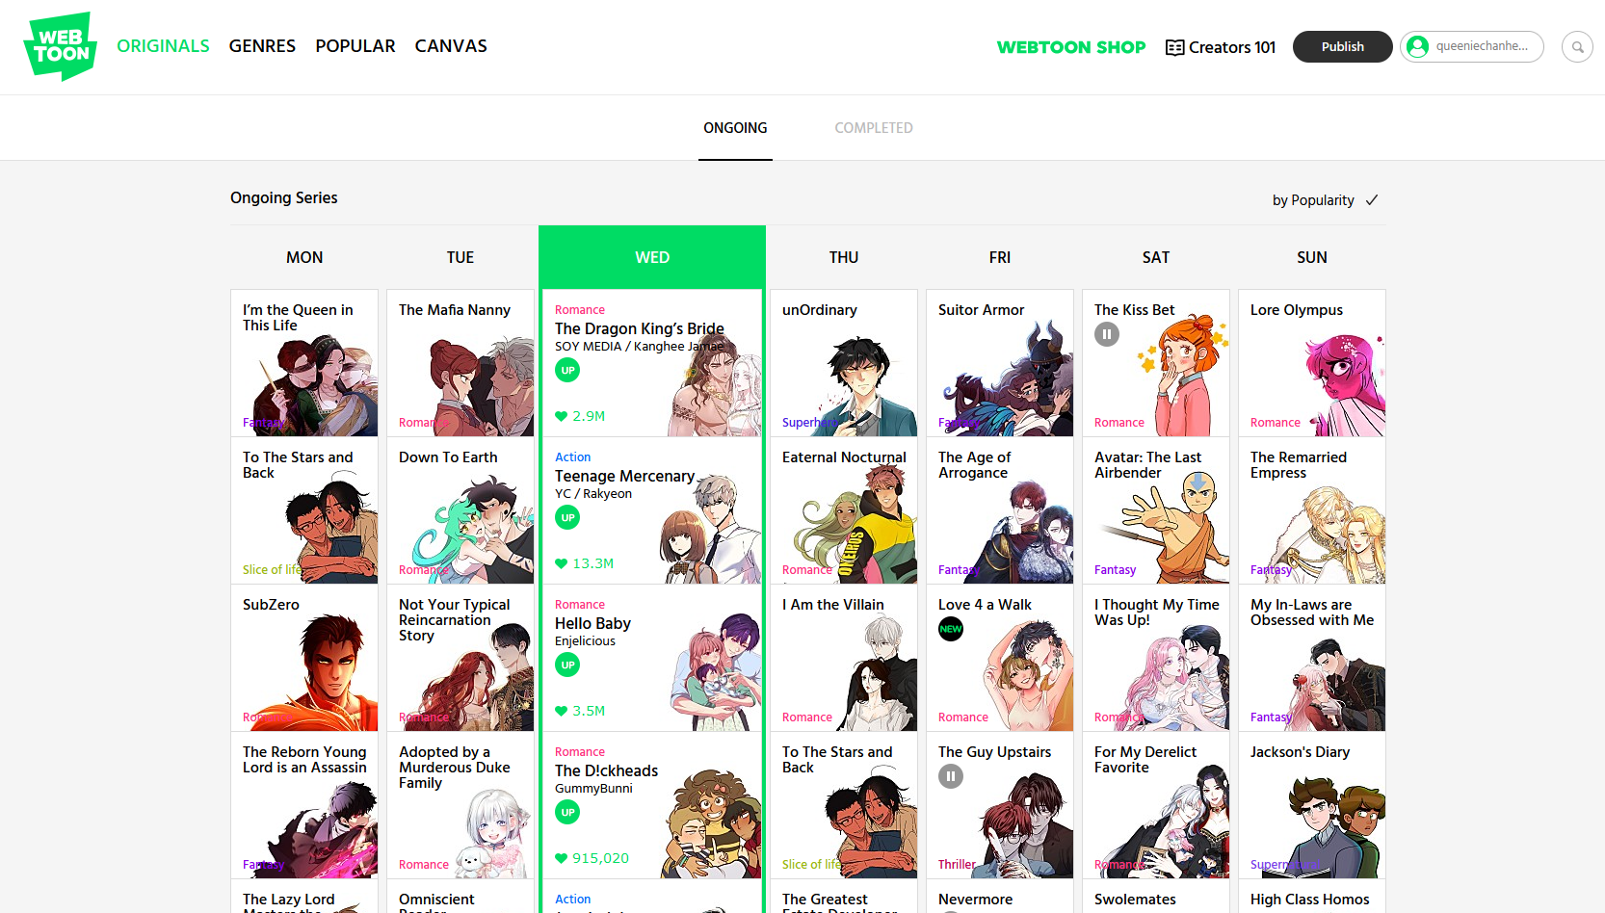
Webtoons Originals – PAID PROs

Slide 11
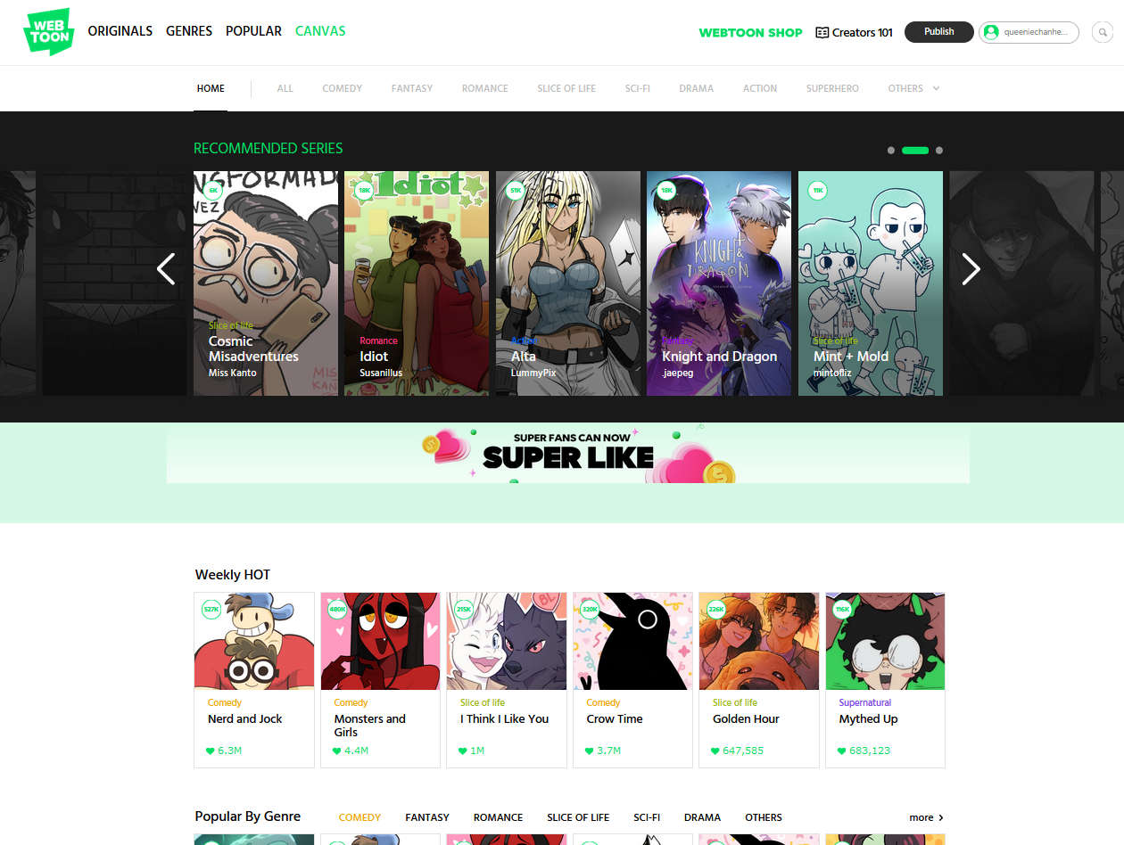
Webtoons CANVAS – FREE AMATEURs

Slide 12
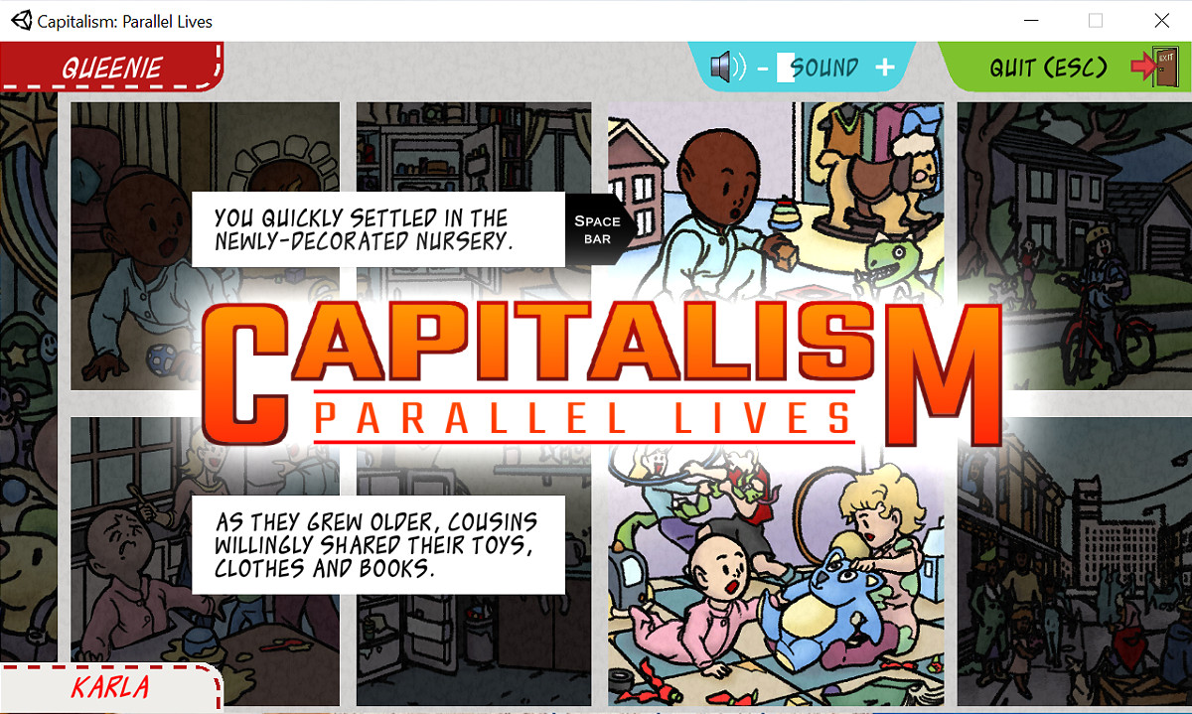
My own Comic-Game Hybrid

Slide 13
“On A Plate” by Tobey Morris (2015)
https://www.rnz.co.nz/news/the-wireless/373065/the-pencilsword-on-a-plate

Slide 14
Thank you
Queenie Chan
queenie@queeniechan.com
www.queeniechan.com/phd

